Slide 1
TodayInHistory ChatBot
Team 14
Praveen Goswami
Rohan Suryawanshi
Arman Attar
Yashaswini Chaudhari
Pooja Tingane
Atul Sonawale
Ayushi Mehta

Slide 2
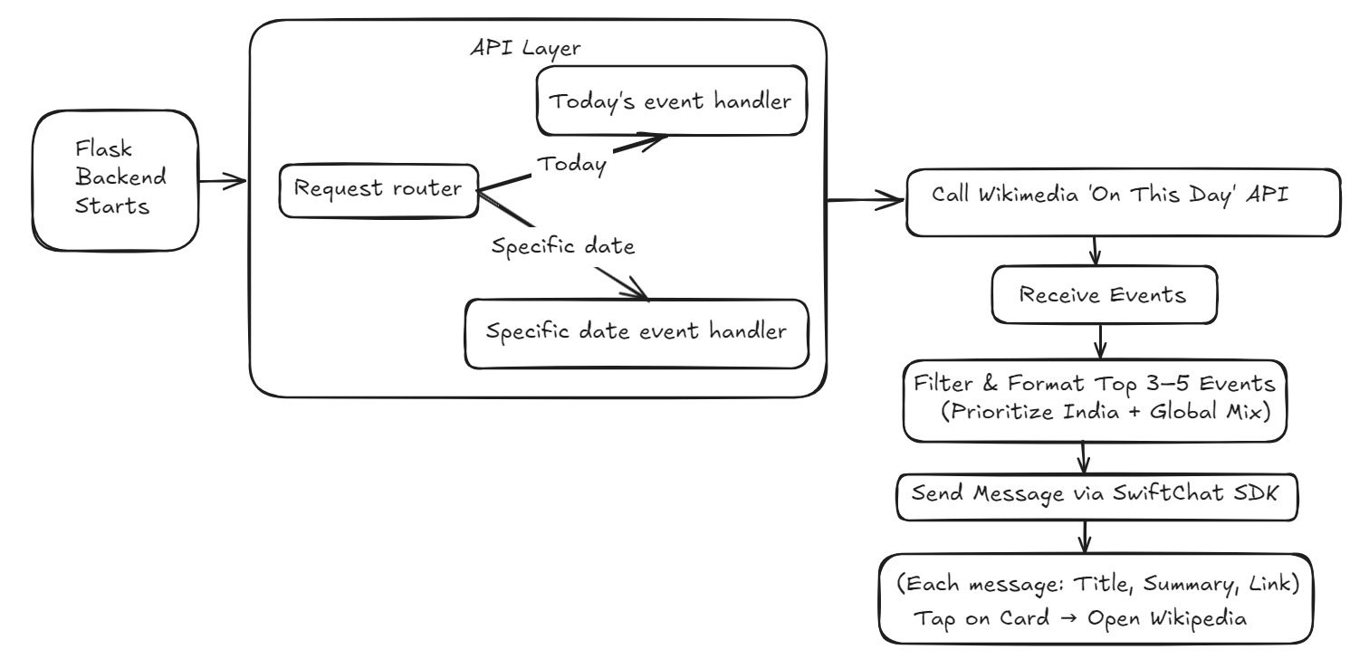

Slide 3
The Tech Behind It
Flask (Python) to manage the backend,
The Wikimedia “On This Day” API to fetch real-time historical events,
And SwiftChat SDK to present messages in an interactive, user-friendly way.

Slide 4
Future Scalability
Event Categorization
Interactive Carousel
Tap to Dive Deeper
Event Filtering & Prioritization
AI-Driven Summarization

Slide 5
Thank You

